Slide 1
Lecture 2: More about Microprocessor
Syed Shakil Mahmud
Lecturer
Department of Computer Science and Engineering
BAIUST

Slide 2
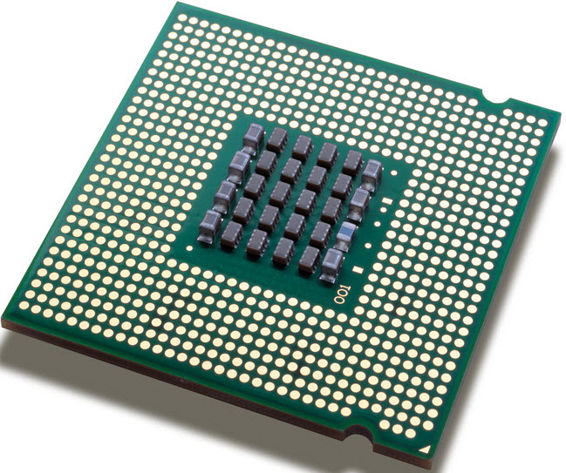
What is Microprocessor?
The Microprocessor is a programmable integrated device that has computing and decision-making capability similar to that of the central processing unit (CPU) of a computer.
Can be:
1) embedded in a larger system
2) a stand alone unit controlling processor
A Microprocessor (μp) is a multipurpose, programmable, clock-driven, register based electronic device that reads binary instructions from a storage device called memory, accepts binary data as input and process data according to those instructions and provides results as output.

Slide 3
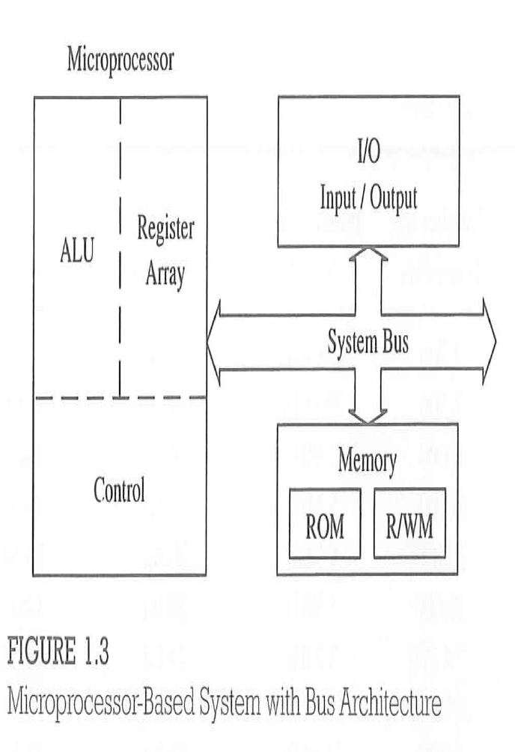
Microprocessor-based System with Bus Architecture

Slide 4
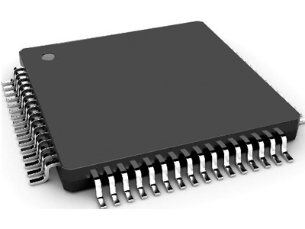
What is Microcontroller
A microcontroller is a compact integrated circuit designed to govern a specific operation in an embedded system.
A typical microcontroller includes a processor, memory and input/output (I/O) peripherals on a single chip.

Slide 5
Block Diagram of a Microcontroller

Slide 6
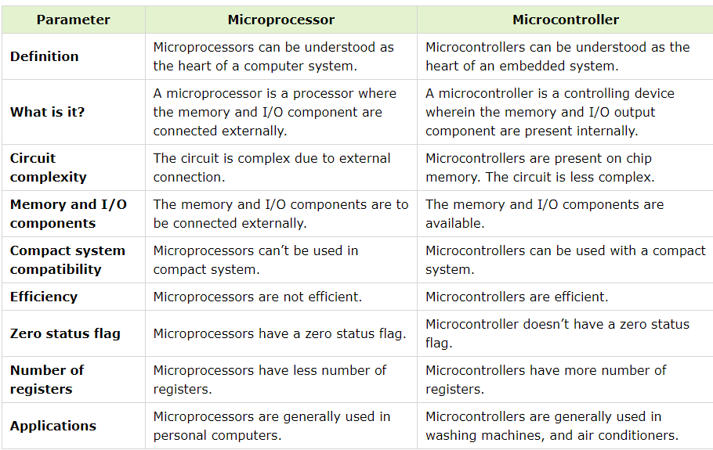
Difference between Microprocessor and Microcontroller

Slide 7
Scale of Integration
SSI (Small-scale Integration)
MSI (Medium-scale Integration)
LSI (Large-scale Integration)
VLSI

Slide 8
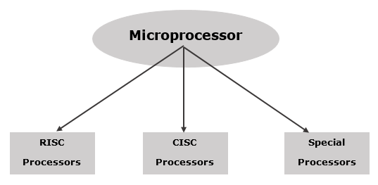
Microprocessor - Classification

Slide 9
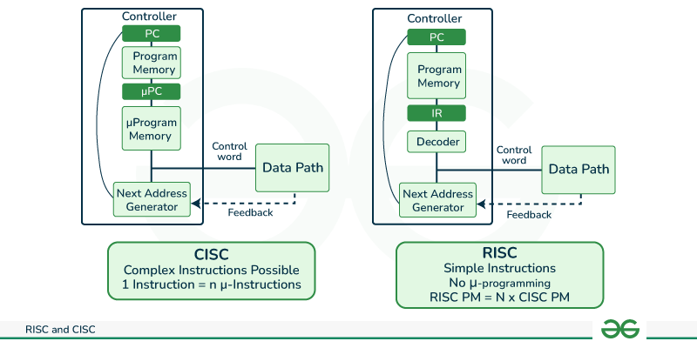
RISC and CISC

Slide 10
RISC Processor
RISC stands for Reduced Instruction Set Computer. It is designed to reduce the execution time by simplifying the instruction set of the computer. Using RISC processors, each instruction requires only one clock cycle to execute results in uniform execution time. This reduces the efficiency as there are more lines of code, hence more RAM is needed to store the instructions. The compiler also has to work more to convert high-level language instructions into machine code.
Some of the RISC processors are −
Power PC: 601, 604, 615, 620
DEC Alpha: 210642, 211066, 21068, 21164
MIPS: TS (R10000) RISC Processor
PA-RISC: HP 7100LC

Slide 11
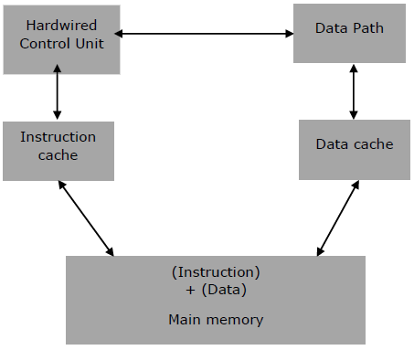
Architecture of RISC

Slide 12
Characteristics of RISC
It consists of simple instructions.
It supports various data-type formats.
It utilizes simple addressing modes and fixed length instructions for pipelining.
It supports register to use in any context.
One cycle execution time.
“LOAD” and “STORE” instructions are used to access the memory location.
It consists of larger number of registers.
It consists of less number of transistors.

Slide 13
CISC Processor
CISC stands for Complex Instruction Set Computer. It is designed to minimize the number of instructions per program, ignoring the number of cycles per instruction. The emphasis is on building complex instructions directly into the hardware.
The compiler has to do very little work to translate a high-level language into assembly level language/machine code because the length of the code is relatively short, so very little RAM is required to store the instructions.
Some of the CISC Processors are −
IBM 370/168
VAX 11/780
Intel 80486

Slide 14
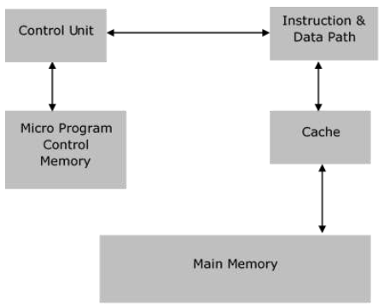
Architecture of CISC

Slide 15
Characteristics of CISC
Variety of addressing modes.
Larger number of instructions.
Variable length of instruction formats.
Several cycles may be required to execute one instruction.
Instruction-decoding logic is complex.
One instruction is required to support multiple addressing modes.

Slide 16
Special Processors
Coprocessor
A coprocessor is a specially designed microprocessor, which can handle its particular function many times faster than the ordinary microprocessor.
For example − Math Coprocessor.
Some Intel math-coprocessors are −
8087-used with 8086
80287-used with 80286
80387-used with 80386

Slide 17
Special Processors
Input/Output Processor
It is a specially designed microprocessor having a local memory of its own, which is used to control I/O devices with minimum CPU involvement.
For example −
DMA (direct Memory Access) controller
Keyboard/mouse controller
Graphic display controller
SCSI port controller

Slide 18
Applications of RISC and CISC
RISC is used in high-end applications like video processing, telecommunications and image processing.
CISC is used in low-end applications such as security systems, home automation, etc.

Slide 19
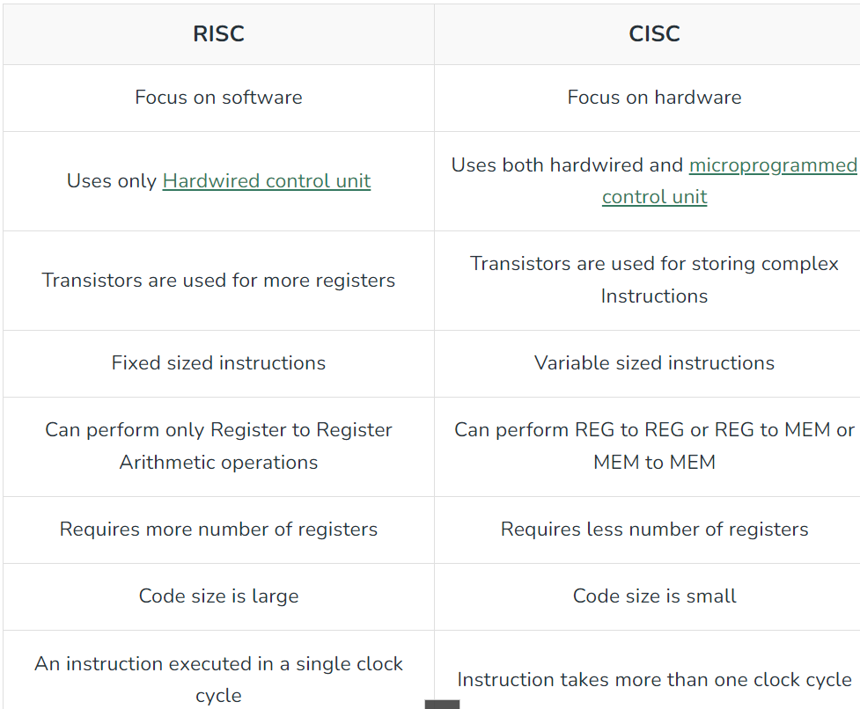
CISC vs RISC

Slide 20
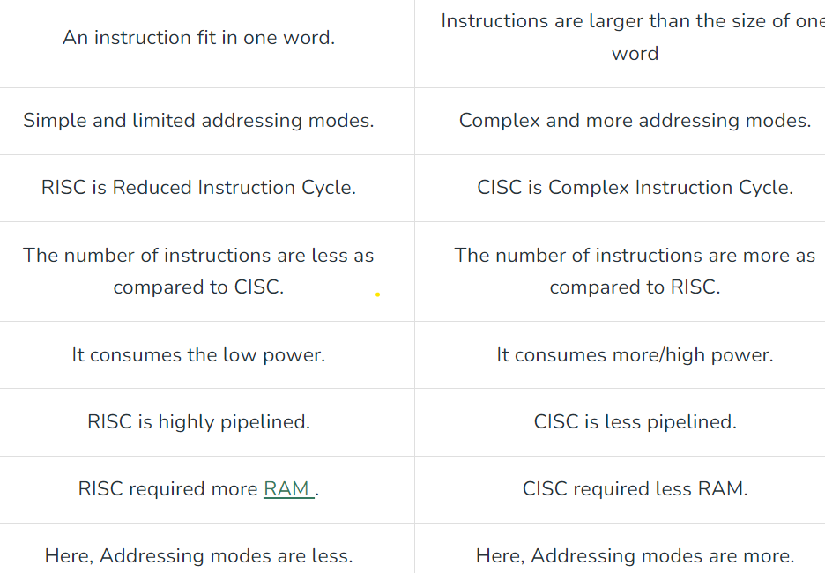
CISC vs RISC

Slide 21
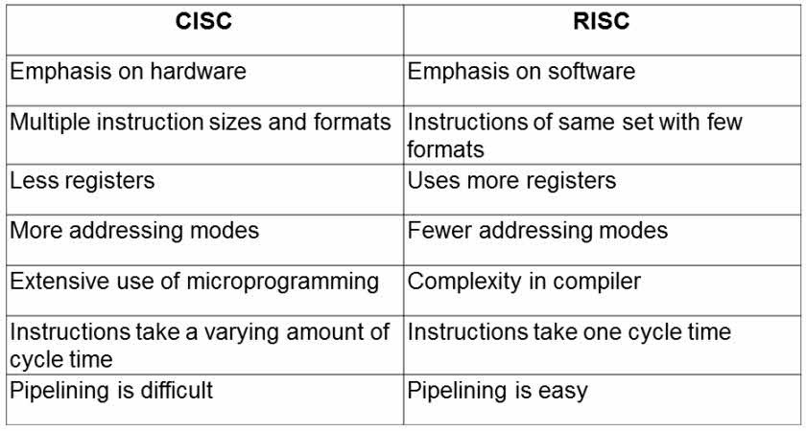
CISC vs RISC

Slide 22
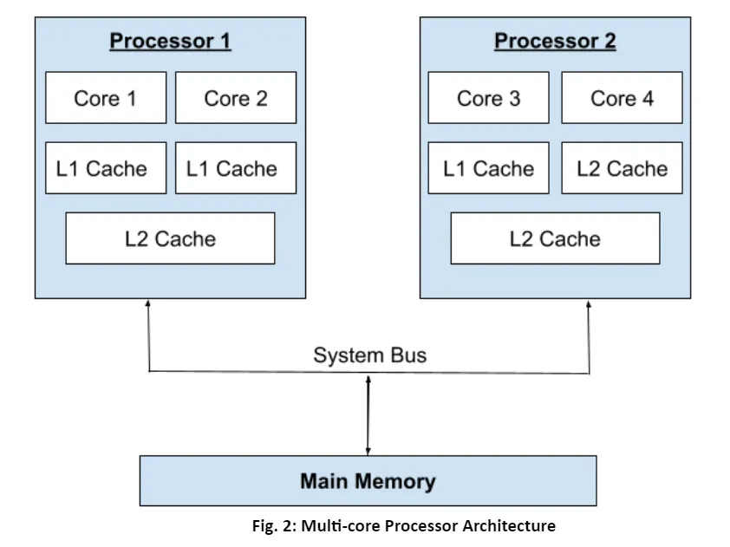
Multi-Core Processor
A multi-core processor is an integrated circuit that combines two or more processors to execute numerous tasks at once, minimise power consumption, and boost performance. It has multiple instructions, which means that various cores run different threads that access different regions of memory.

Slide 23
Homework
Explain the difference between the machine language and the assembly language of a computer.
Explain the advantages of an assembly language over high-level languages.
Explain the terms: low-level and high-level language.

